Slide 1
Software Engineering and
Best Practices
Sources: Various.
Rational Software Corporation slides,
OOSE textbook slides, Per Kroll talk, How to Fail with the RUP article, textbooks
Most slides have been modified considerably
Bob Roggio - UNF
… and I modified his slides…

Slide 2
What is Software Engineering?
The process of solving customers’ problems by the systematic development and evolution of large, high-quality software systems within cost, time and other constraints
Note:
  Process, systematic (not ad hoc), evolutionary…
  Constraints: high quality, cost, time, meets user requirements

Slide 3
Comments:
$250 billion annually in US.
Over 175,000 projects!
Complexity, size, distribution, importance push our limits.
Business pushes these limits:
  Great demands for rapid development and deployment
➔ Incredible pressure: develop systems that are:
  On time,
  Within budget,
  Meets the users’ requirements
Figures in the late 90s indicated that at most
  70% of projects completed
  Over 50% ran over twice the intended budget
  $81 billion dollars spent in cancelled projects!!
Getting better, but we need better tools and techniques!

Slide 4
What Happens in Practice
Sequential activities: (Traditional ‘Waterfall’ Process)
Requirements Design Code Integration Test
100%
Integration
Begins
Risk inadequately addressed
Process not receptive to Change
Problems not really ‘seen’
until near delivery date!
Until then, ‘all is well…’
Big Bang approach – full delivery
Long development cycles…
Little user involvement, etc. etc…
Late Design
Breakage
Development Progress
(% coded)
Original
Target Date
Project Schedule

Slide 5
Waterfall
Requirements
Design
Code
Integration
System
Test
T I M E

Slide 6
Symptoms of Software Development Problems
Inaccurate understanding of end-user needs
Inability to deal with changing requirements
Modules that don’t fit together (integration)
Software that’s hard to maintain or extend (brittle)
Late discovery of serious project flaws (integration)
Poor software quality (architecture, risks unanticipated…)
Process not responsive to Change (Gantt Charts…)
Unacceptable software performance
Team members in each other’s way, unable to reconstruct who changed what, when, where, why (software architecture, …
…and we could go on and on…
Notes:
These symptoms are readily observable in the real world. Just like in the medical world, it is not sufficient to treat the symptoms. One must address the root causes (as shown on the next page).
An example of treating the symptoms is addressing the second bullet by insisting that no changes to requirements be accepted after a certain date. This is unrealistic. Change will happen to the business environment regardless, and the result may be that users reject the system that is built since it has not adapted to their changing needs.
Encourage student interaction on this slide. One possibility is to ask students for symptoms of problems they have observed, before you show the slide. You could then compare the students’ list to this list. Or you could show the list first and ask for additional symptoms that students have observed.

Slide 7
Need a Better Hammer!
We need a process that
  Will serve as a framework for large scale and small projects
  ➔ Adaptive – embraces ‘change!’
    Opportunity for improvement not identification of failure!
  Iterative (small, incremental ‘deliverables’)
  Risk-driven (identify / resolve risks up front)
  Flexible, customizable process (not a burden; adaptive to projects)
  Architecture-centric (breaks components into ‘layers’ or common areas of responsibility…)
  Heavy user involvement
Identify best ways of doing things – a better process – acknowledged by world leaders…

Slide 8
Addressing Root Causes Eliminates the Symptoms
Symptoms
end-user needs
changing requirements
modules don’t fit
hard to maintain
late discovery
poor quality
poor performance
colliding developers
build-and-release
Root Causes
insufficient requirements
ambiguous communications
brittle architectures
overwhelming complexity
undetected inconsistencies
poor testing
subjective assessment
waterfall development
uncontrolled change
insufficient automation
Best Practices
develop iteratively
manage requirements
use component architectures
model the software visually
verify quality
control changes
Symptoms of problems can be traced to having Root Causes.
Best Practices are ‘practices’ designed to address the root causes of software problems.
Notes:
We don’t expect students to read this chart. It is an abstract view that shows the many to many relationships among the symptoms and root causes, and between the root causes and practices. It is meant to indicate that we have done the mapping, so they don’t have to.
Animation notes:
This animation is automatic. It shows the tracing from symptoms to root causes to the best practices we will discuss.

Slide 9
Best Practices of Software Engineering
Develop Iteratively
Use
Component
Architectures
Manage
Requirements
Model
Visually
Verify
Quality
Control Changes

Slide 10
Practice 1: Develop Software Iteratively
Develop Iteratively
Use
Component
Architectures
Manage
Requirements
Model
Visually
Verify
Quality
Control Changes
Considered by many practitioners to be the most significant of the six
Notes:
We need to keep the concept of iterative development at a very high level in this module. It is easy to get bogged down in the many ramifications of iterative development.
Try just to get the concept across here. If they would like to have more information, they can take the Rational Unified Process Overview course. Project managers might be interested in the Unified Software Project Management course.

Slide 11
Practice 1: Develop Software Iteratively
Until recently, developed under assumption - most requirements can be identified up front.
The research deconstructing this myth includes work by Capers Jones. (See next slide) In this very large study of 6,700 projects, creeping requirements — those not anticipated near the start—are a very significant fact of software development life, ranging from around 25% on average projects up to 50% on larger ones.

Slide 12
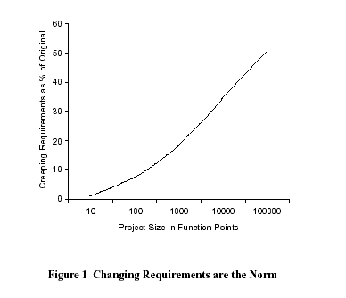
➔ Look up a definition of ‘Function Points.’

Slide 13
Interestingly,
An initial design will likely be flawed with respect to its key requirements. Requirements rarely fully known up front!
Late-phase discovery of design defects results in costly over-runs and/or project cancellation
  Oftentimes requirements change – even during implementation!

Slide 14
Interestingly,
While large projects are more prone to cost overruns, medium-size/small projects are vulnerable to cancellation.
The key reasons continue to be
  poor project planning and management,
  shortage of technical and project management expertise,
  lack of technology infrastructure,
  disinterested senior management, and
  inappropriate project teams.”

Slide 15
Waterfall Delays Risks
Walker Royce, 1995
R
I
S
K
Requirements
Design
Code
Waterfall risk
Integration
System
Test
T I M E

Slide 16
Iterative Development
Iteration 1
Iteration 2
Iteration 3
➔ Earliest iterations address greatest risks
Each iteration produces an executable release
Each iteration includes integration, test, and assessment!
Objective Milestones: short-term focus; short term successes!

Slide 17
Accelerate Risk Reduction
Walker Royce, 1995
R
I
S
K
Risk reduction
Waterfall risk
Iterative
Iteration
Iteration
Iteration
Iteration
Iteration
T I M E

Slide 18
Iterative Development Characteristics
Critical risks are resolved before making large investments
Initial iterations enable early user feedback
Testing and integration are continuous –Partial implementations can be deployed
  Waterfall method – no delivery
No big-bang approach!

Slide 19
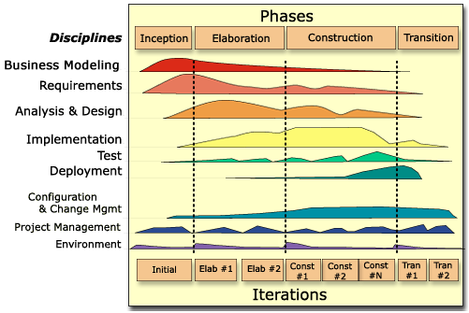
UP Lifecycle Graph – Showing Iterations
STUDY THIS!!!
In an iteration, you may walk through all disciplines
C
O
N
T
E
N
T
S
T
R
U
C
T
U
R
E
T I M E

Slide 20
Problems Addressed by Iterative Development
Root Causes
Solutions
Insufficient requirements
Ambiguous communications
Brittle architectures
Overwhelming complexity
Subjective assessment
Undetected inconsistencies
Poor testing
Waterfall development
Uncontrolled change
Insufficient automation
Enables and encourages user feedback
Serious misunderstandings evident early in the life cycle
Development focuses on critical issues – break it down!
Objective assessment thru testing and assessment
Inconsistencies detected early
Testing starts earlier – continuous!
Risks identified and addressed early - via planned iterations!

Slide 21
Iterations Are Time-boxed
Work is undertaken within an iteration.
The iteration plan defines the artifacts to be delivered, roles and activities.
An iteration is clearly measurable.
Iterations are risk-driven
Iterations are planned.
Iterations are assessed!
Notes:
This presentation does not attempt to describe in detail the iterative software development process. Good references on iterative development are contained within the Rational Unified Process itself.
Suffice it to say that RUP is an incremental process whereby the overall project is broken down into phases and iterations. The important aspects of iterative development from a plan perspective are:
The iteration plan provides a detailed description of the upcoming phase of work.
It defines the roles, activities and artifacts delivered in that iteration.
It has a very clear set of measurement criteria which can be assessed at the end (and during) the iteration.
An iteration should deliver an executable piece of software that is demonstratable and testable against the project’s requirements and use cases.
An iteration should be time boxed-meaning that it should have a definite duration; Beginning and end.
Iterations are the mechanism that the project manager uses to mitigate risk. Therefore, each iteration should reduce the overall risk to the project.

Slide 22

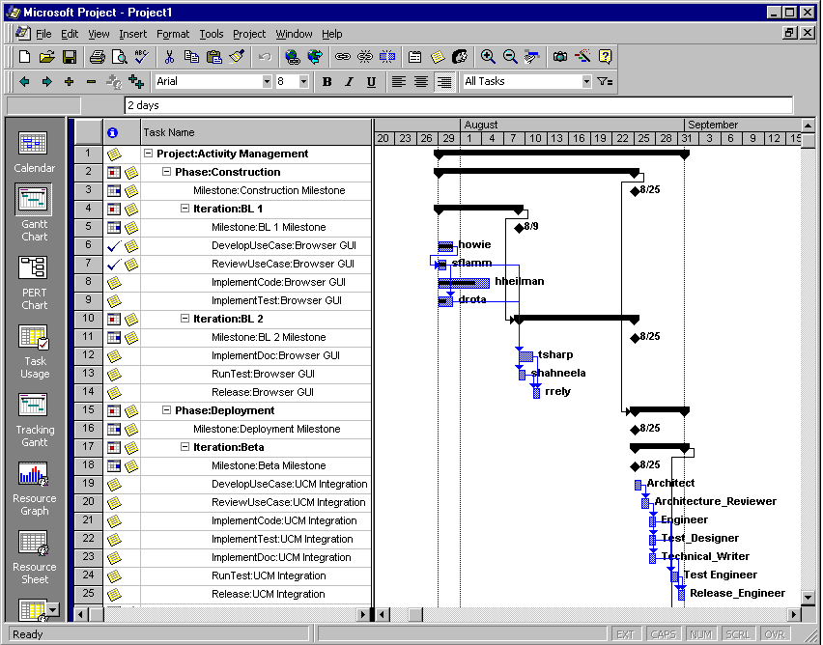

The Iteration Plan Defines….
The deliverables for that iteration.
artifacts
The to do list for the team members
Notes:
Once you have defined your coarse grained project plan, then an iteration plan is developed at a more detailed level prior to each and every iteration. In short, iteration plans are the roadmap for each iteration. Each phase has a series of milestones associated with it. Each iteration in a phase moves the project towards these milestones. An iteration has a clear objective defined and associated with that objective are the activities and deliverables required to accomplish that objective.

Slide 23
Plan With Evolving Levels of Detail
Coarse-grained Plan:
Software Development Plan
Fine-grained Plans: Iteration Plans
One For Entire Project
Next Iteration
Phases and major milestones
What and when
Iterations for each phase
Number of iterations
Objectives and Duration
Current Iteration
Iterative Development does not mean less work and shorter schedule
It is about greater predictability

